Slide 1

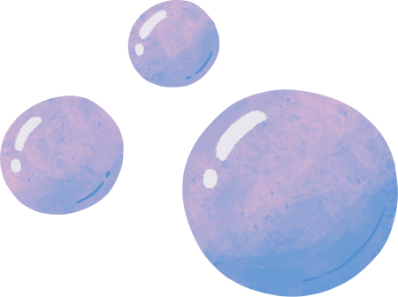

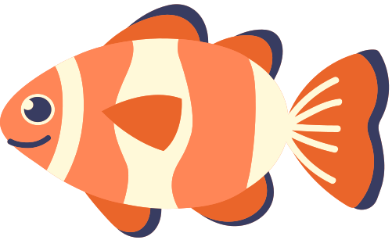
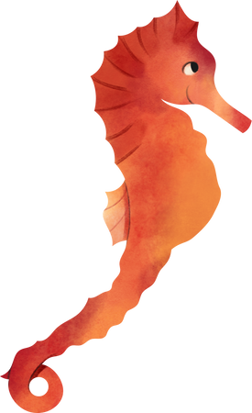



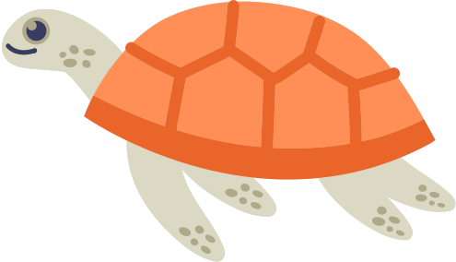

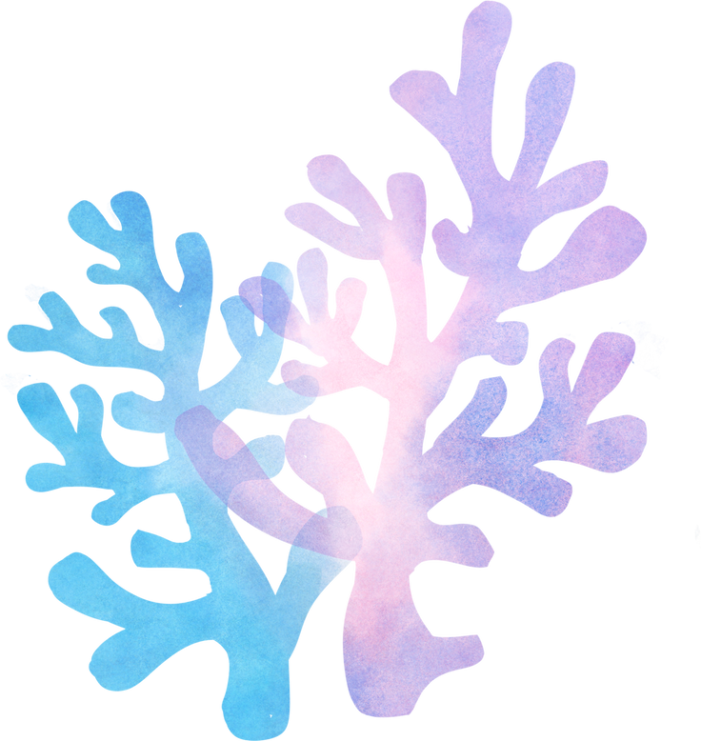

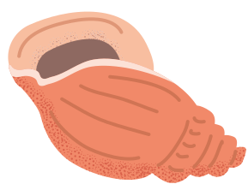

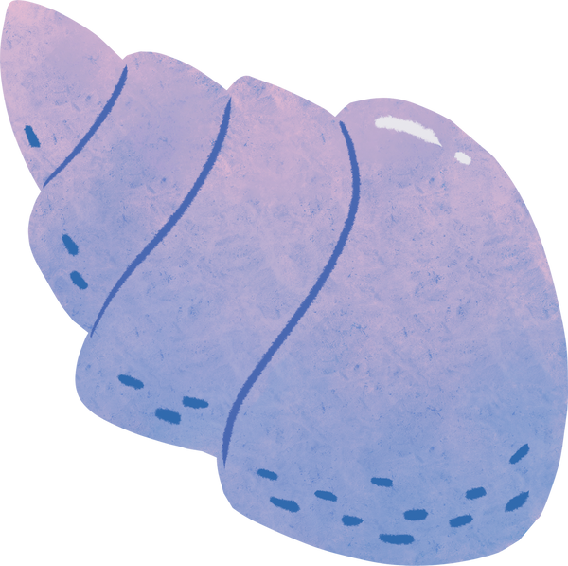

Turtle
Conservation
Humna Sultan

Slide 2



The Issue at Hand:
Turtle populations declining rapidly
Climate change and environmental issues causing negative effects for animals that support the ecosystem
Need to change habits and way that we treat the environment to preserve species

Slide 3
Statistics:
90% population decline of Eastern Pacific leatherbacks over last 30 years
Tens of thousands of sea turtles lost each year to overharvesting + illegal trade
4,950 turtles caught each year as bycatch by Indonesian longline vessels alone
https://www.worldwildlife.org/pages/infographic-sea-turtles

Slide 4
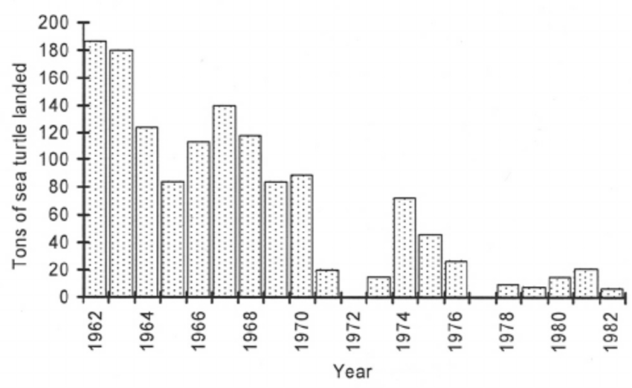
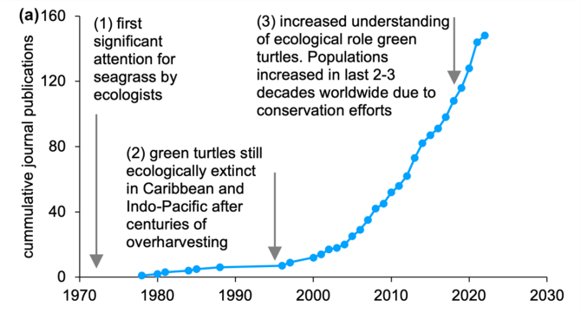
https://www.wur.nl/en/show/sea-turtles-are-returning-what-are-the-effects-on-ecosystem-functioning.htm
https://www.researchgate.net/figure/Summary-of-reported-sea-turtle-landings-primarily-Chelonia-mydas-in-Bah-a-de-los_fig2_45787034

Slide 5
Why Do We Care?
Turtles promote existing cycles in the ecosystem
Help other species that we rely on
Damage to turtles → damage to other species (including us!)
Complete ecosystem will be negatively impacted + needs to adjust

Slide 6
What Can We Do?
Bring awareness to the issue
Work towards being more environmentally friendly
Prevent further pollution + environmental harm
Understand root causes of the problem
Do research + analyze data!

Slide 7
My Dataset
analysis of skeletal growth marks in humerus bones of turtles in St. Joseph Bay, Florida - January 2010
Stranding_ID_Number, Sex, Straightline_Carapace_Length, Growth_Rate, Age, Year
Added ID numbers (increasing by row)
- not in original dataset
https://www.fisheries.noaa.gov/inport/item/36195

Slide 8
My Data
Turtle Schema
1, database, 3 tables: turtleSex, turtleGrowthRate, turtleSexGrowthRate (dynamic)
Select statements pertaining to sex, growth rate, etc.
Trying to understand relationship between Sex and Growth Rate
https://www.fisheries.noaa.gov/inport/item/36195

Slide 9
